Slide 1

CAR PRICE PREDICTION PROJECT
Submitted By:
Lakshmi Rajendra Thute

Slide 2
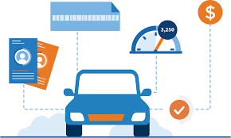
INTRODUCTION
With the covid 19 impact in the market, we have seen lot of changes in the car market. Now some cars are in demand hence making them costly and some are not in demand hence cheaper. One of our clients works with small traders, who sell used cars. With the change in market due to covid 19 impact, our client is facing problems with their previous car price valuation machine learning models. So, they are looking for new machine learning models from new data. We have to make car price valuation model.
For this we have to scrape the data from various used car websites such as OLX, Car Dekho, Cars24 etc. The scraped data must contain features as Brand, model, variant, manufacturing year, driven kilometres, fuel, number of owners, location and the target variable Price.

Slide 3
ANALYTICAL PROBLEM FRAMING
With the Coronavirus sway on the lookout, we have seen lot of changes in the vehicle market. Presently some vehicles are sought after subsequently making them exorbitant and some are not popular consequently less expensive. With the adjustment of market due to Coronavirus 19 effect, people/sellers are facing issues with their past Car Price valuation AI/Machine Learning models. Along these lines, they are searching for new AI models from new information. Here we are building the new car price valuation model.
The primary point of this venture is to create a dataset with the help of web scraping and anticipate the cost of trade-in vehicle in view of different elements.

Slide 4
COLUMN DESCRIPTION
There are total 9 columns, 8 features and 1 target:
'Brand & Model' : It gives us the brand of the car along with its model name and manufacturing year
'Variant' : It gives us the variant of particular car model
'Fuel Type' : It gives us the type of fuel used by the car
'Driven Kilometers' : It gives us the total distance in kms covered by car
'Transmission' : It tells us whether the gear transmission is Manual or Automatic
'Owner' : It tells us the total numbers of owners car had previously
'Location' : It gives us the location of the car
'Date of Posting Ad' : It tells us when the advertisement for selling that car was posted online
'Price (in ₹)' : It gives us the price of the car.
Here 'Price (in ₹)' is our target variable.

Slide 5
DATA SOURCES AND THEIR FORMATS
I got the dataset in CSV format and I read the data in Jupyter Notebook using pandas data frame.

Slide 6
DATA CLEANING AND PRE-PROCESSING

Slide 7
EXPLORATORY DATA ANALYSIS
Observations
Brands, Variants, Driven Kilometers & Location columns have high no of values.
Maximum Cars run on either Petrol or diesel. Only few goes for CNG and other fuels.
Maximum Cars have Manual transmission.
Maximum cars are being sold by their very 1st Owner.
We have collected the cars posted online in last one month, from 25th December 2021 to 27th January 2022.
Almost all the cars have a price ranging in between 270000 to 1165101.

Slide 8
Here Brands, Variants, Driven Kilometers & Location have a wide range of values in them, we will not perform bivariate analysis for them as they will not give us any specific details. Now by plotting graph of Fuel type, Transmission and Owner against Price, we conclude that Car that uses Diesel, have automatic Transmission and Has only 1 owner is more likely to have a high price.

Slide 10
LABEL ENCODING

Slide 11
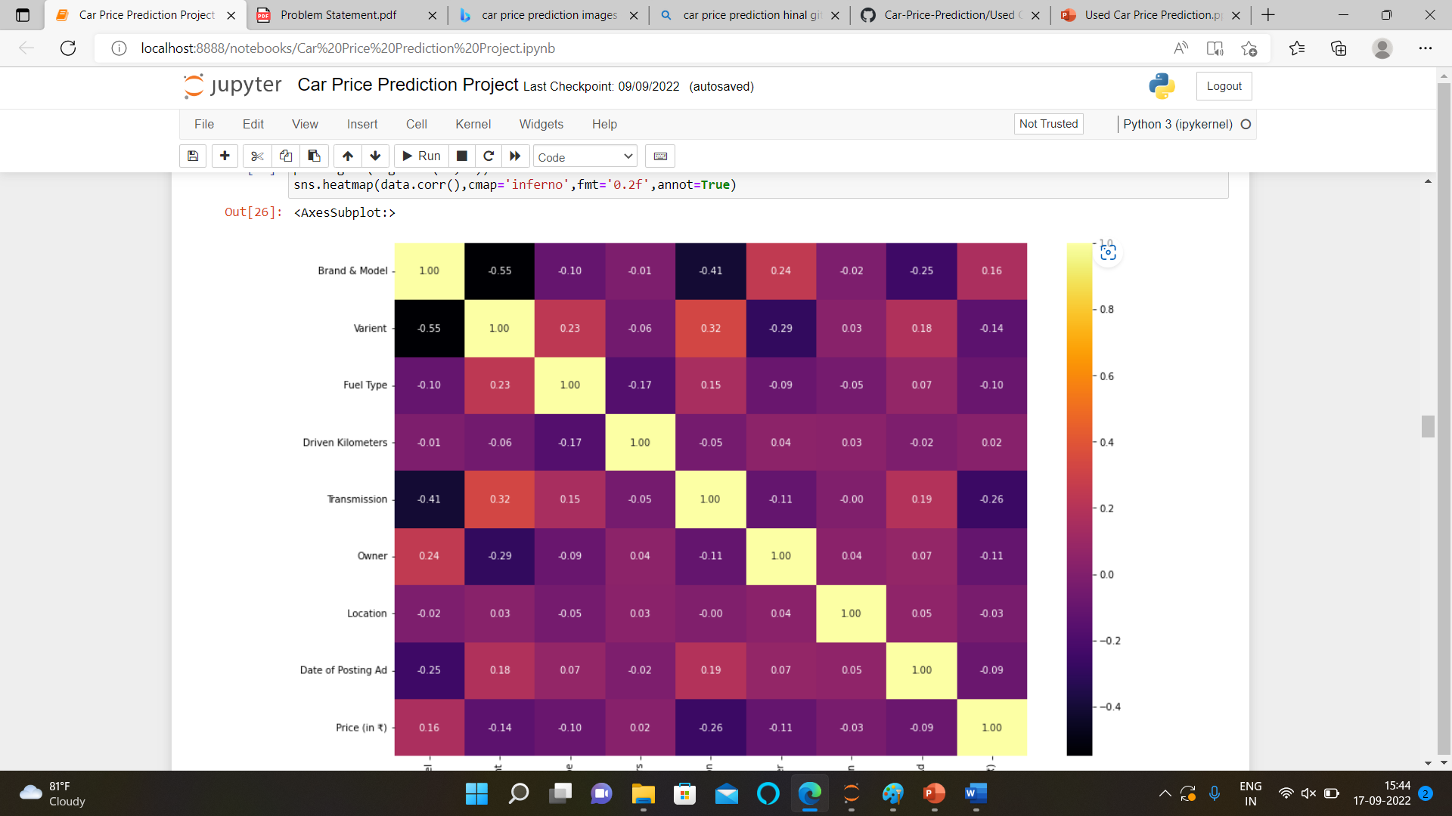
MULTICOLLINEARITY CHECKED

Slide 12
MODEL BUILDING AND EVALUATION
Testing of Identified Approaches (Algorithms)
Linear Regression
Random Forest Regressor
Support Vector Regressor
Gradient Boosting Regressor
AdaBoost Regressor
Extra Trees Regressor 8. SGD Regressor

Slide 13
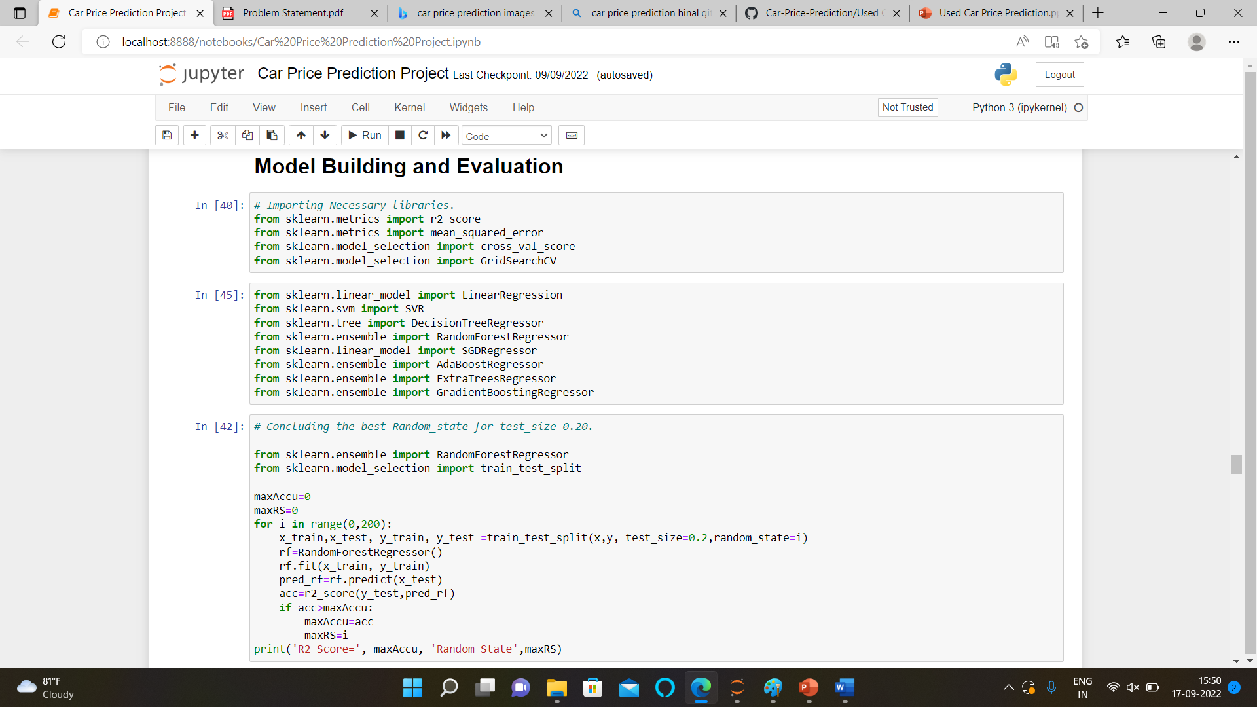

Slide 18
HYPER PARAMETER TUNNING

Slide 19
CONCLUSION
Here after hyper parameter tunning we can see most of the datapoints are close to best fit line and we got the final r2 score as 89% which very good.

Slide 20
THANK YOU

